Slide 1
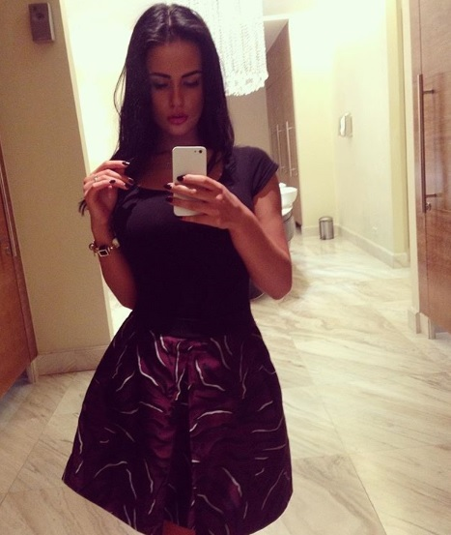
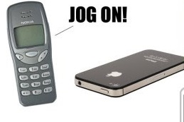
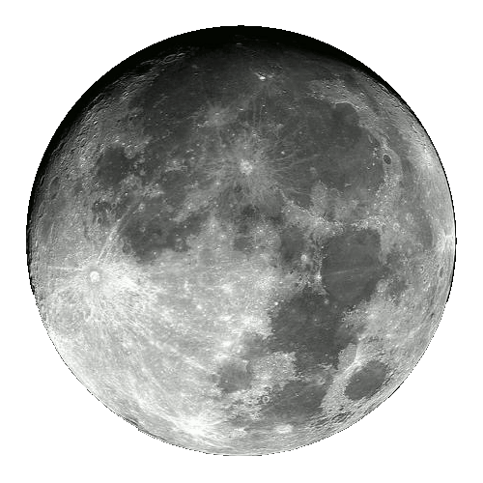
M
A SMART SITE
Login
Join NOW
Evolve From ZERO to ONE
& from One to
WHERE SOMETHING SPECIAL HAPPENS
EVERY DAY
My Myraah .My Infinity
Phone Companies – did - Innovate
WEBSITE
COVER
INTUTION
Quantified
Because
You Deserve More.
INSIGHTS
Phones became SMART phones
ACTION TIGHT
BUT
Our Websites remain the Same Old.
@Myraah we say : No More.
LUCK
NOW
Inside
Quo Vadis: Get a SMART SITE:
Not just a WEBSITE
Powered by AI

Slide 2
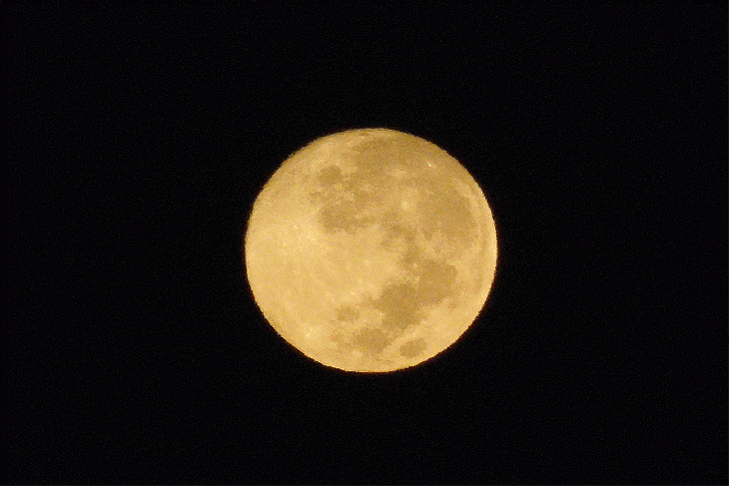
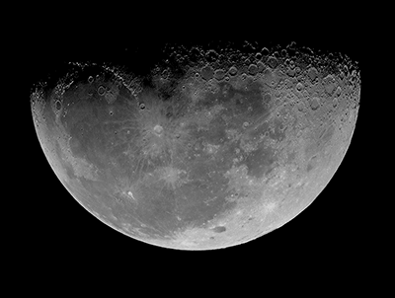
M
A SMART SITE
Login
Join NOW
Evolve From ZERO to ONE
& from One to
WHERE SOMETHING SPECIAL HAPPENS
EVERY DAY
My Myraah .My Infinity
Phone Companies – did - Innovate
Because
You Deserve More.
Phones became SMART phones
BUT
Our Websites remain the Same Old.
@Myraah we say : No More.
Get a SMART SITE – Not just a WEBSITE
Powered by AI

Slide 3
M
A SMART SITE
Login
Join NOW
Evolve From ZERO to ONE
& from One to
WHERE SOMETHING SPECIAL HAPPENS
EVERY DAY
My Myraah .My Infinity
Phone Companies – did - Innovate
UNDER
COVER
COVER
UNCOVER
Because
You Deserve More.
UNCOVER
Phones became SMART phones
BUT
Our Websites remain the Same Old.
@Myraah we say : No More.
Get a SMART SITE – Not just a WEBSITE
Powered by AI

Slide 4
M
A SMART SITE
Login
Join NOW
Evolve From ZERO to ONE
& from One to
WHERE SOMETHING SPECIAL HAPPENS
EVERY DAY
My Myraah .My Infinity
Phone Companies – did - Innovate
INTUITION
OR
COVER
Because
You Deserve More.
I N
TUITION
Phones became SMART phones
BUT
Our Websites remain the Same Old.
@Myraah we say : No More.
Get a SMART SITE – Not just a WEBSITE
Powered by AI

Slide 5
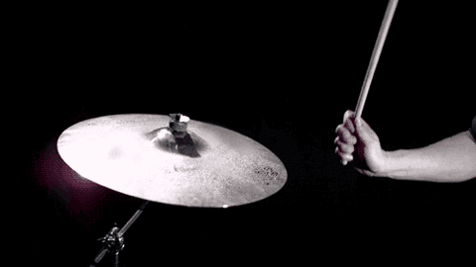
M
A SMART SITE
Login
Join NOW
Evolve From ZERO to ONE
& from One to
WHERE SOMETHING SPECIAL HAPPENS
EVERY DAY
My Myraah .My Infinity
Phone Companies – did - Innovate
INTUITION
QUANTIFIED
COVER
Because
You Deserve More.
Phones became SMART phones
BUT
Our Websites remain the Same Old.
@Myraah we say : No More.
Get a SMART SITE – Not just a WEBSITE
Powered by AI

Slide 6
M
A SMART SITE
Login
Join NOW
Evolve From ZERO to ONE
& from One to
WHERE SOMETHING SPECIAL HAPPENS
EVERY DAY
My Myraah .My Infinity
Phone Companies – did - Innovate
INTUITION
QUANTIFIED
COVER
Because
You Deserve More.
I N
TUITION
Phones became SMART phones
BUT
Our Websites remain the Same Old.
@Myraah we say : No More.
Get a SMART SITE – Not just a WEBSITE
Powered by AI

Slide 7
M
A SMART SITE
Login
Join NOW
Evolve From ZERO to ONE
& from One to
WHERE SOMETHING SPECIAL HAPPENS
EVERY DAY
My Myraah .My Infinity
Phone Companies – did - Innovate
INTUITION
I S
COVER
Because
You Deserve More.
I N
TUITION
Phones became SMART phones
BUT
Our Websites remain the Same Old.
@Myraah we say : No More.
a SMART SITE – Not just a WEBSITE
Powered by AI

Slide 8
UNDER
COVER
COVER
UNCOVER
UNCOVER
Because
You Deserve More.
Powered by AI

Slide 9
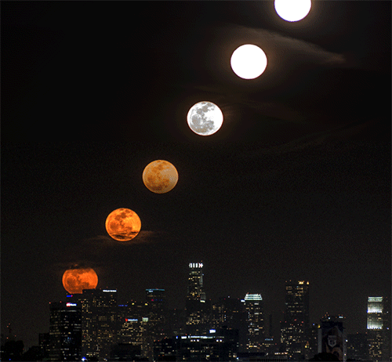
M
A SMART SITE
Login
Join NOW
Evolve From ZERO to ONE
& from One to
WHERE SOMETHING SPECIAL HAPPENS
EVERY DAY
My Myraah .My Infinity
Phone Companies – did - Innovate
Because
You Deserve More.
Phones became SMART phones
BUT
Our Websites remain the Same Old.
@Myraah we say : No More.
Get a SMART SITE – Not just a WEBSITE
Powered by AI

