Slide 1
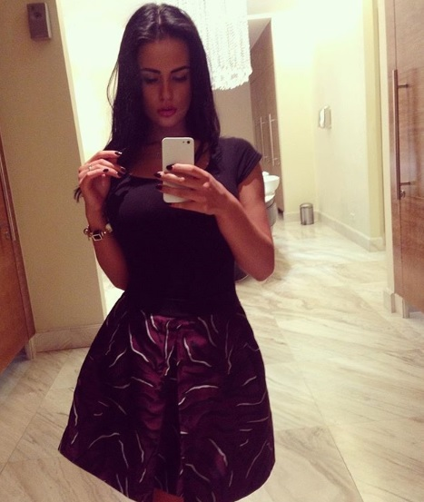
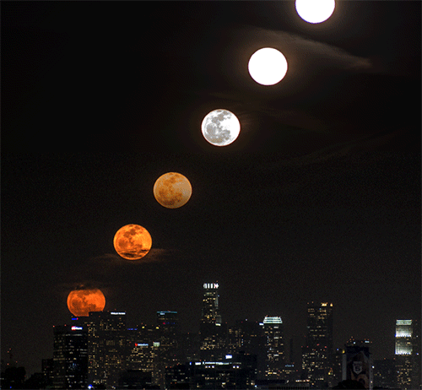
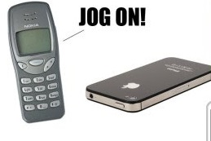
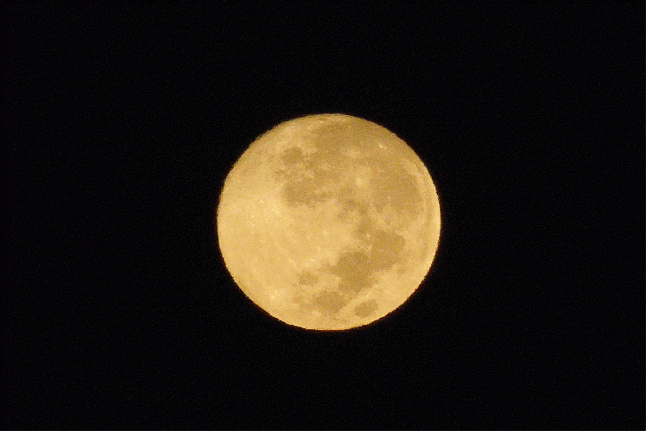
M
A SMART SITE
Evolve From ZERO to ONE
& from One to
WHERE SOMETHING SPECIAL HAPPENS
EVERY DAY
My Myraah .My Infinity
Phone Companies – did - Innovate
Because
You Deserve More.
Phones became SMART phones
BUT
Our Websites remain the Same Old.
@Myraah we say : No More.
Get a SMART SITE – Not just a WEBSITE

